Slide 1
Internship Week 2
Samarth Sharma

Slide 2
Understood theory behind MUSIC
Recreated the code in HLS 2019.1 and made the block diagram
Wrote the driver after generating bitstream
Yet to test it out on the board

Slide 3
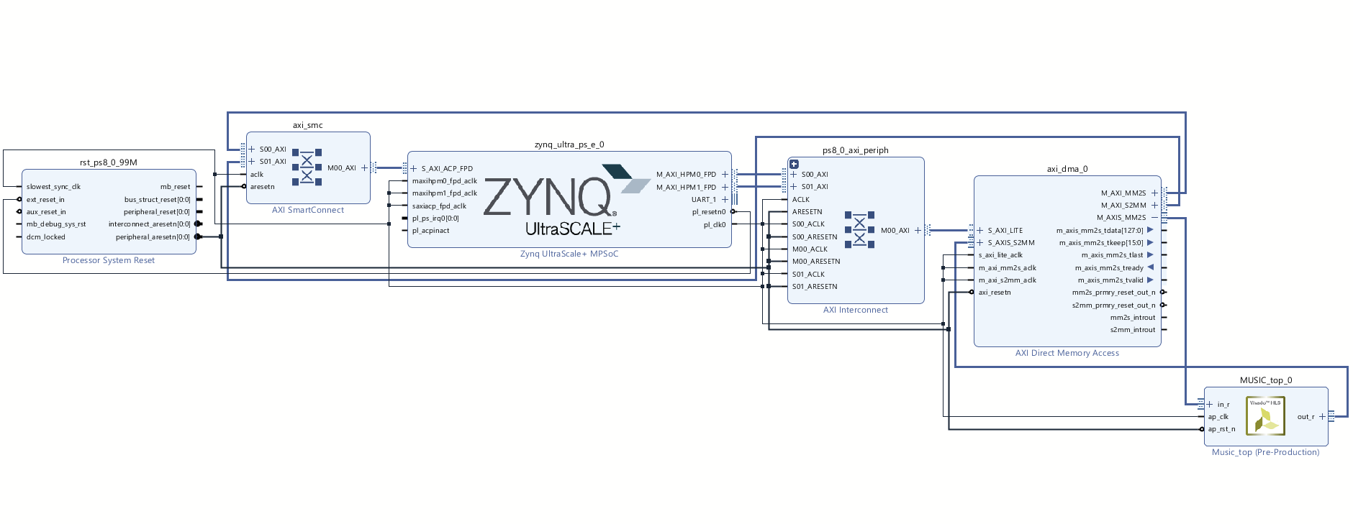
Set up Vivado 2024.2 and Vitis unified IDE on my system.
Tried making block diagrams on ZCU111

Slide 4
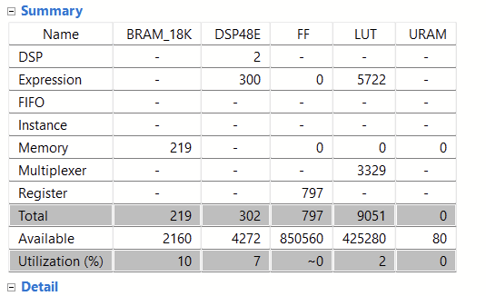
Matrix Multiplication on ZCU111 (Opt w/o WLO)

Slide 5
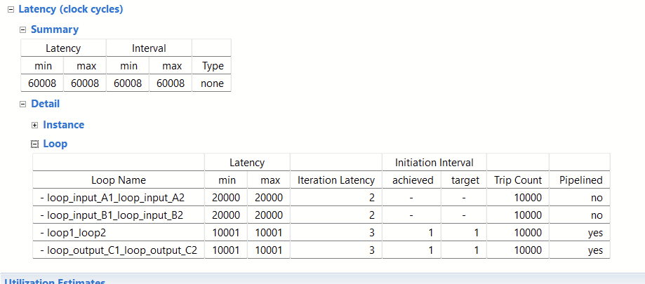

Slide 6
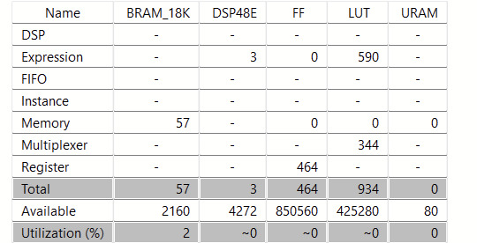
Unoptimized

Slide 7
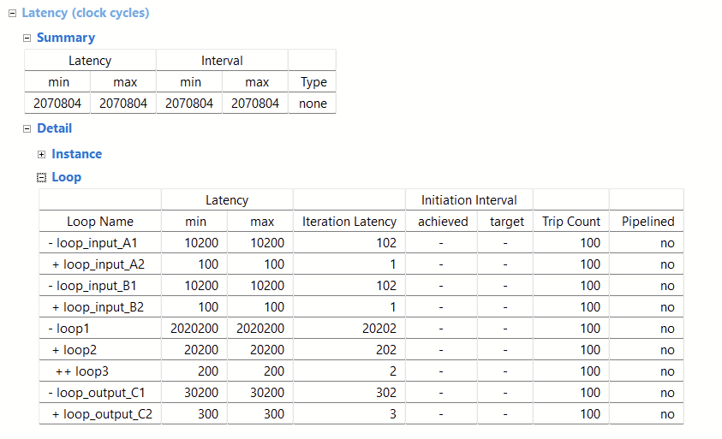

Slide 8
Thank you!

